Slide 1
Smart Parking System using Arduino
Ultrasonic Sensors, PIR, Servo Gates & LCD Display
TEAM NULL POINTERS

Slide 2
Project Overview
Automated parking system using Arduino UNO
Detects car entry, exit, and slot availability
Controls gates using servo motors
Displays slot status on LCD
LCD activates only when motion is detected (PIR)

Slide 3
Main Components Used
Arduino UNO – Main controller
Ultrasonic Sensors – Vehicle detection
Servo Motors – Entry & Exit gates
PIR Sensor – LCD power control
16x2 LCD – Slot availability display

Slide 4
Car Entry – Working Mechanism
1. Car approaches entry gate
2. Entry ultrasonic sensor detects the car
3. Distance becomes less than threshold (30 cm)
4. Servo motor rotates to OPEN the entry gate
5. Car enters the parking area

Slide 5
Slot Detection – Working Mechanism
1. Each parking slot has one ultrasonic sensor
2. Sensor measures distance continuously
3. If car is present → distance < 40 cm
4. Slot marked as NOT AVAILABLE (NA)
5. If no car → slot marked as AVAILABLE (A)

Slide 6
LCD Display & PIR Operation
1. PIR sensor detects motion near display
2. LCD backlight turns ON automatically
3. Slot status shown on LCD (Slot 1 / Slot 2)
4. No motion → LCD backlight turns OFF
5. Saves power and increases LCD life

Slide 7
Car Exit – Working Mechanism
1. Car approaches exit gate
2. Exit ultrasonic sensor detects the car
3. Distance < threshold
4. Exit servo motor opens the gate
5. Car exits and gate closes automatically

Slide 8
System Advantages
Fully automatic parking management
Reduces human effort
Real-time slot availability
Energy efficient LCD control
Low cost and easy to implement

Slide 9
Conclusion
Smart parking system improves efficiency
Suitable for malls, offices, and campuses
Can be extended with IoT and mobile apps
Demonstrates real-world Arduino automation

Slide 10
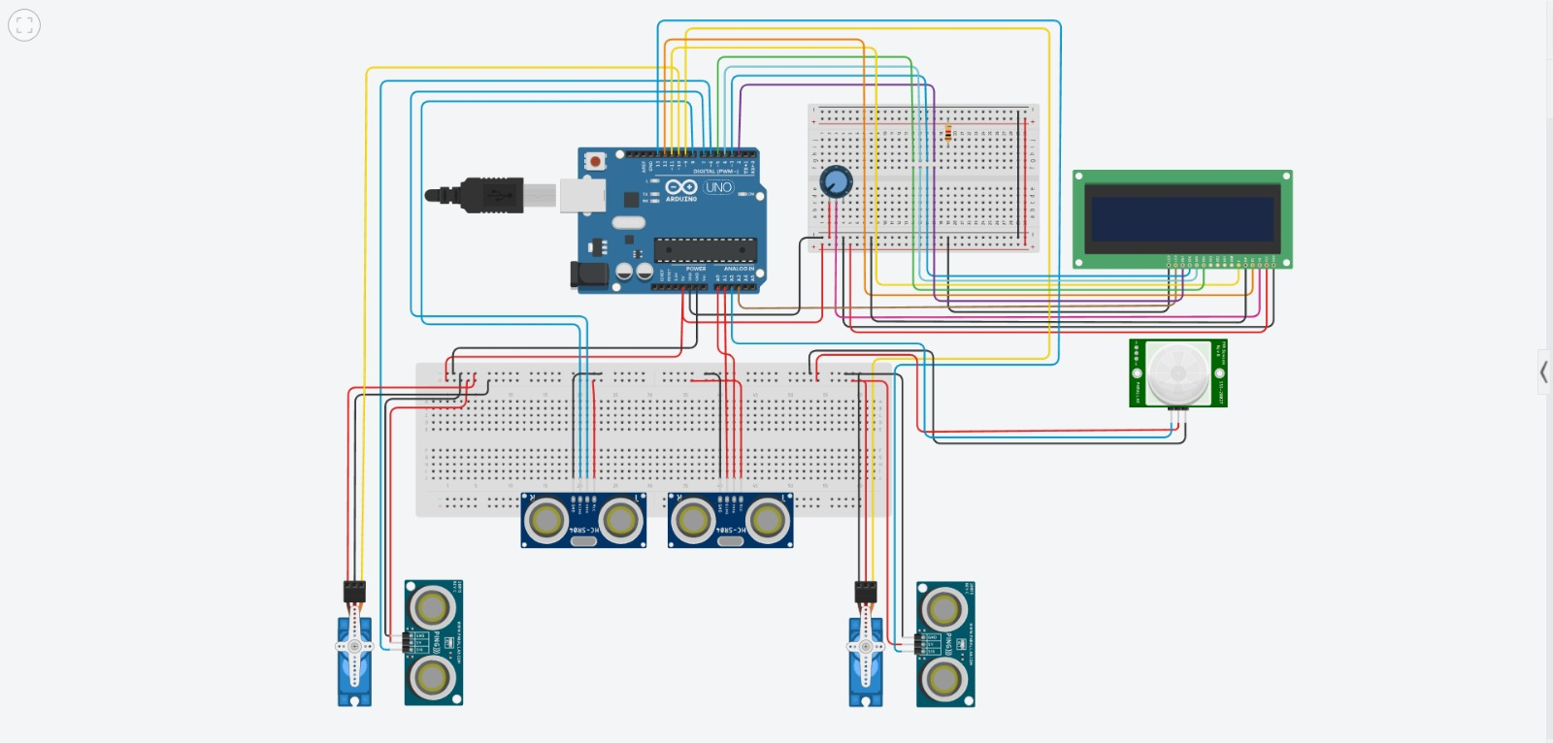
Notes:
Suggested animation:
- Fade-in title
- Fly-in circuit diagram
- Appear arrows while explaining connections

Slide 11
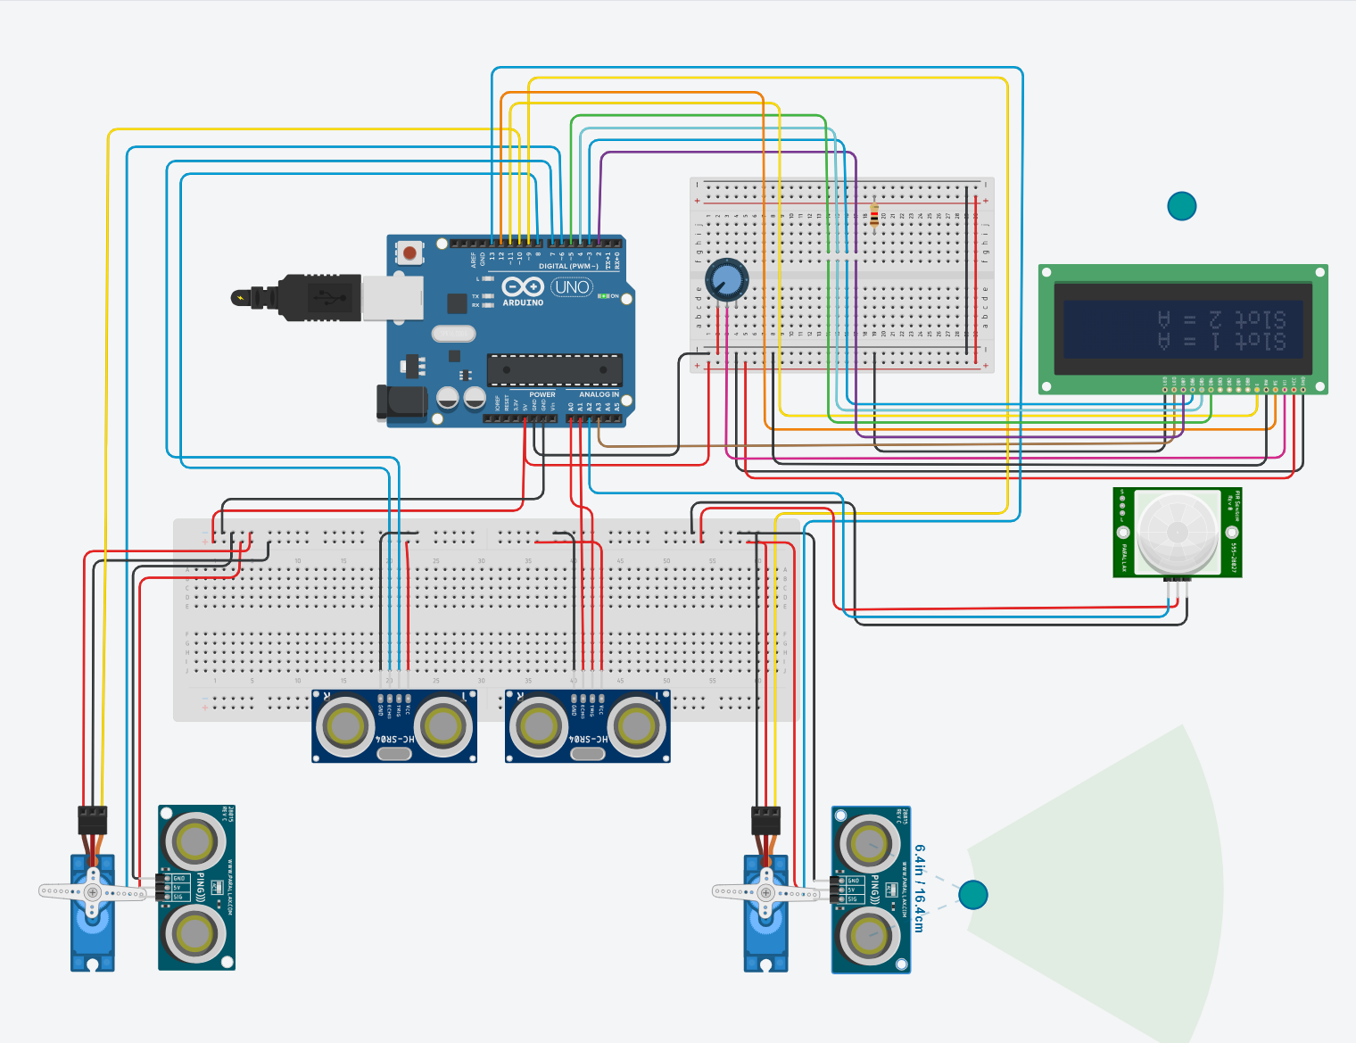


Slide 12
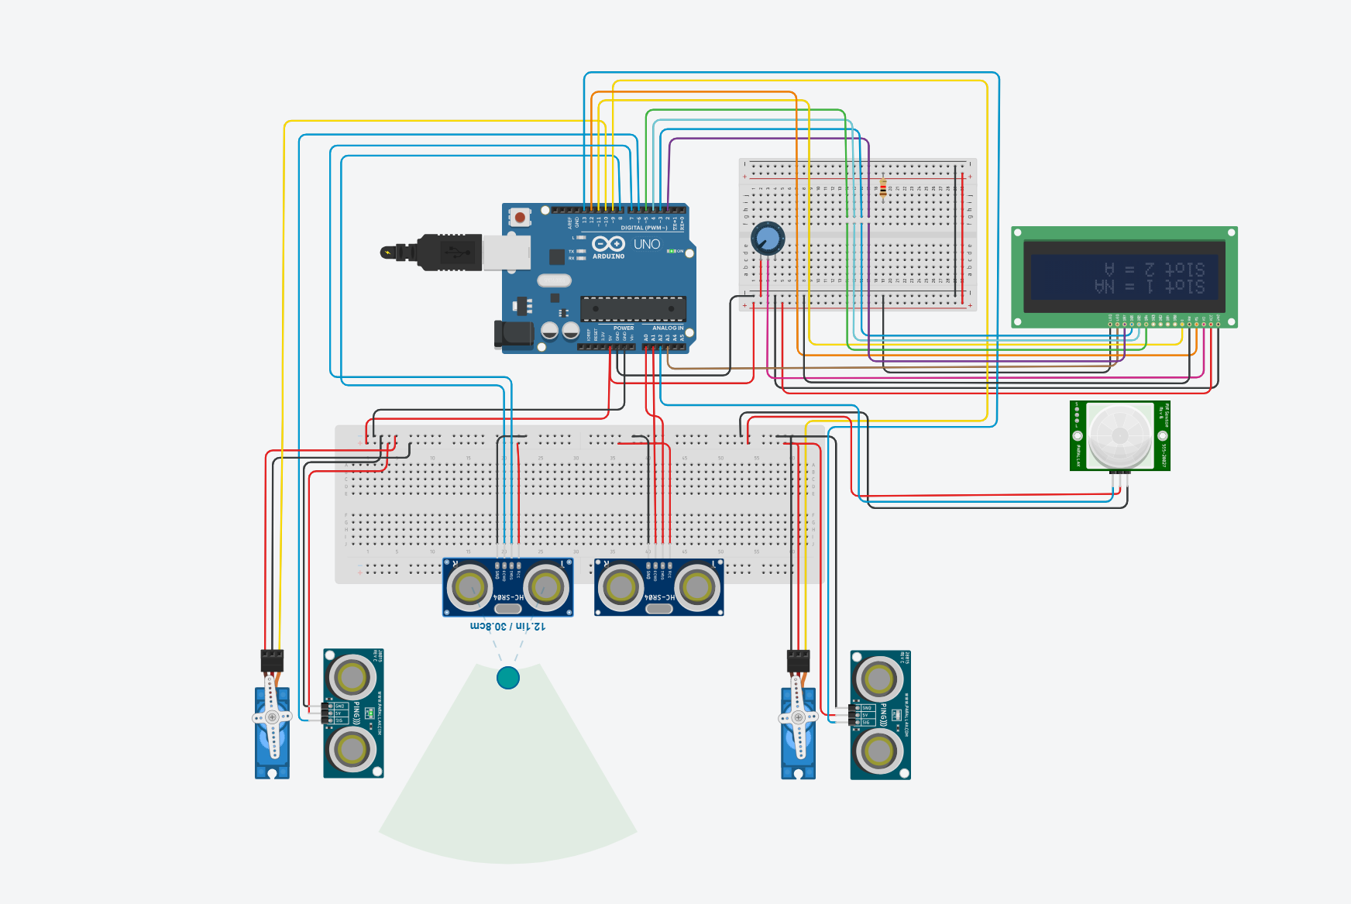

Slide 13
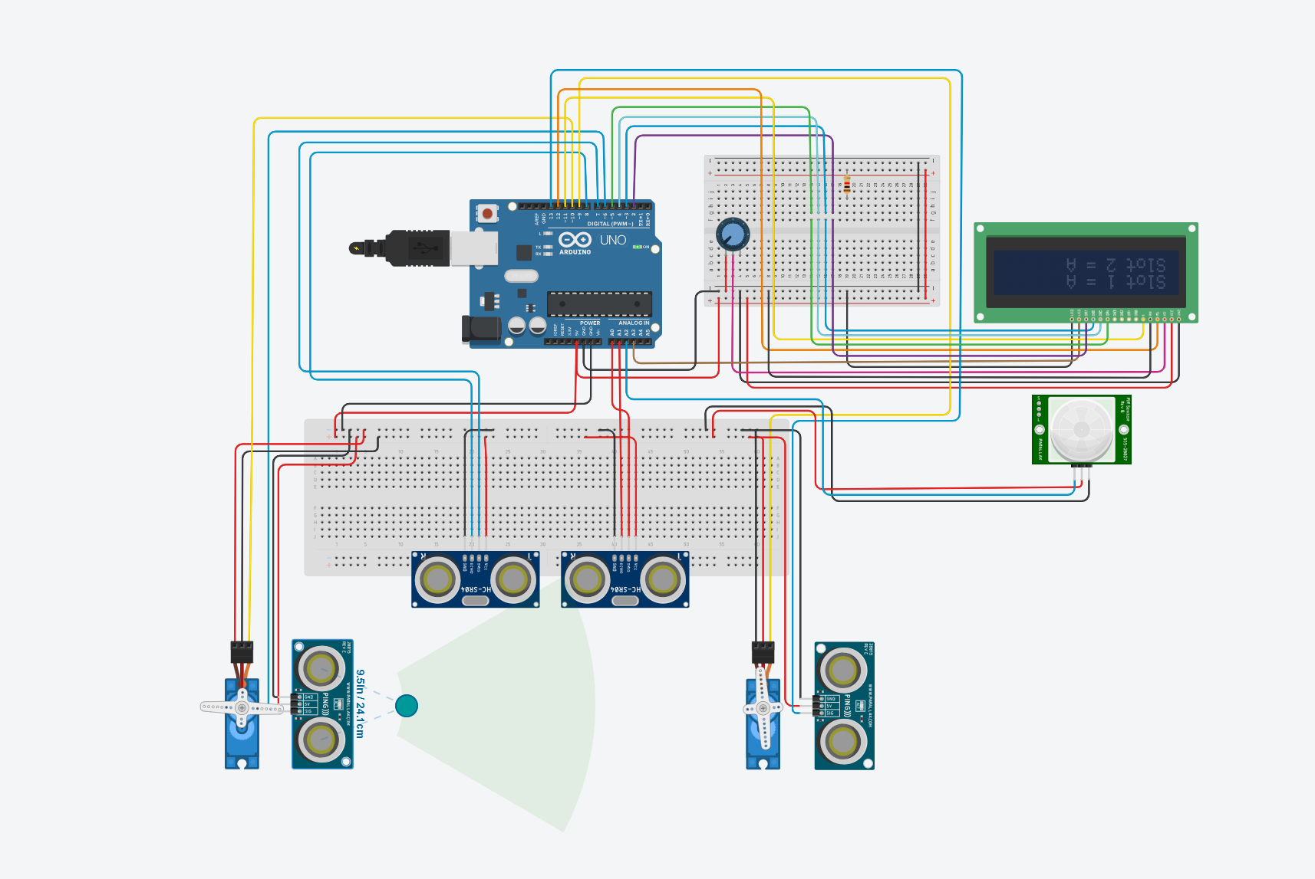

Slide 14
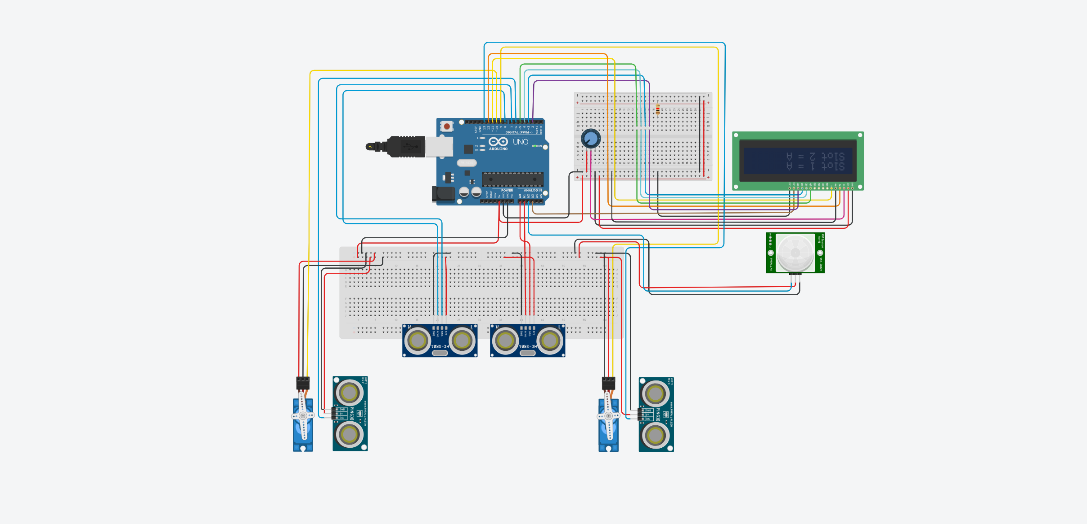

Slide 15



